Slide 1
5/1 Sharing by Shaun

Slide 2
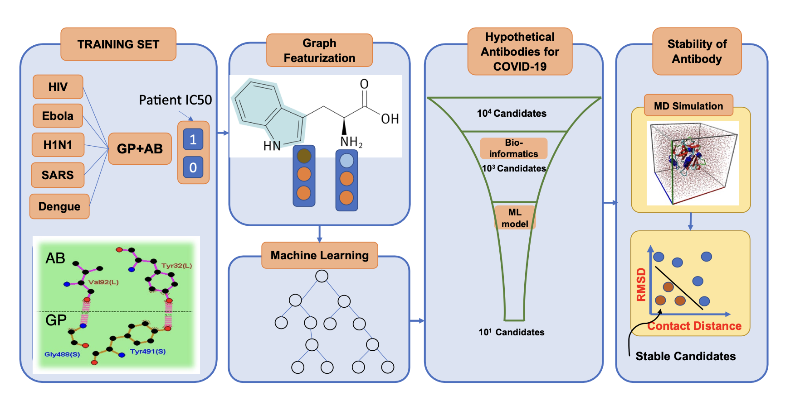
Potential neutralizing antibodies discovered for novel corona virus using machine learning (paper shared earlier)

Slide 3
Steps (which the paper did)
1. Generate training examples data (antibody-antigen complex of different viruses)
2. Train using various ML methods (XGBoost, RF, Logistic Regression etc.)
3. Generate a list of possible antibodies (from point mutations of existing SARS antibodies)
4. Test stability of proposed antibody structures (GROMACs)

Slide 4
1. Generate training examples data (antibody-antigen complex of different viruses)
Paper used 1933 examples of 15 viruses (1833 being HIV)
HIV data collected from CATNAP Database: https://www.hiv.lanl.gov/components/sequence/HIV/neutralization/
CATNAP Purpose: Analyze our database of HIV-1 IC₅₀ and IC₈₀ neutralization data from publicly-available sources, in conjunction with HIV-1 Envelope sequences
Other data collected from by RCSB (PDB) server by searching the keywords of “virus, antibody” (manually obtained)
Antibody and antigen sequence literally just combined together
At that time, there were not much data on COVID antibody-antigen complexes and were not included in data (only 4 SARS data included)
What our URECA project can do:
(i) Manually obtain COVID antibody-antigen data and combine with existing compiled data to strengthen the ML and make it more catered to COVID

Slide 5
1. Generate training examples data (antibody-antigen complex of different viruses)
IC50 values: correspond to neutralization potential
IC50<10 = neutralizing, IC50>10 = non-neutralizing
So training data consists of combined antibody-antigen sequence, along with IC50 values
Training data includes non-neutralizing antibodies as well

Slide 6
2. Train using various ML methods (XGBoost, RF, Logistic Regression etc.)
For one example of data, we have the combined antibody-antigen AA sequence
This sequence treated as an undirected graph, where atoms are nodes and bonds are edges (molecular graphs constructed using RDKit)
Embeddings encode information like the type of atom, valency of an atom, hybridization state, aromaticity etc
Mean pooling conducted over the features for this concatenated embedding to ensure dimensional consistency across the training data
Then passed to various ML methods to predict neutralization potential
These ML methods ultimately try to find the weighted importance of diff features which contribute to their neutralization potential

Slide 7
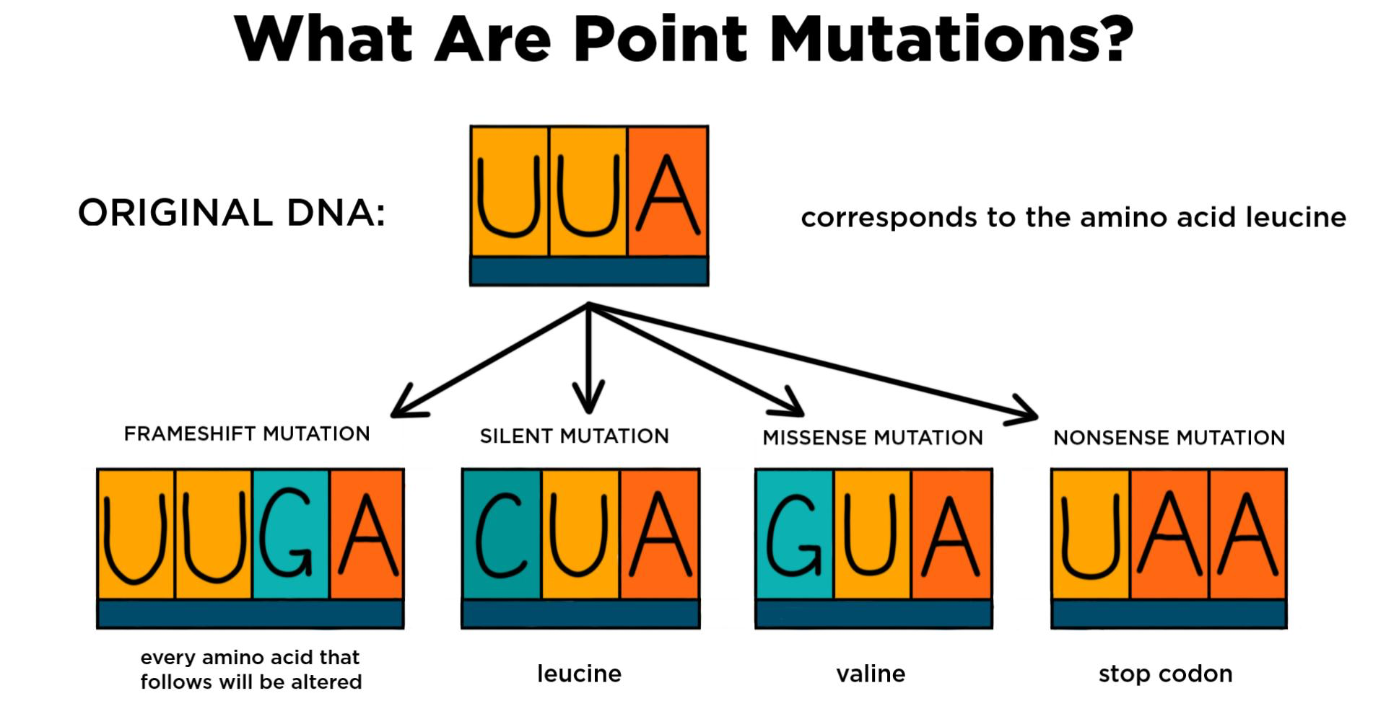
3. Generate a list of possible antibodies (from point mutations of existing SARS antibodies)
The paper only managed to find 4 antibodies which neutralize SARS on PDB
They then used point mutations to generate a list of 2589 possible antibodies (presumably by running a script)

Slide 8
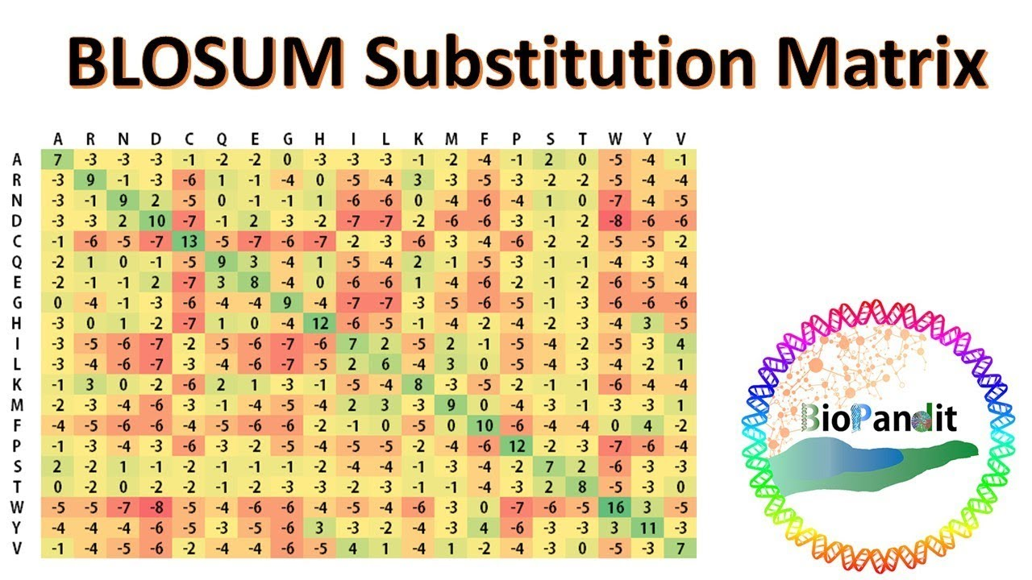
3. Generate a list of possible antibodies (from point mutations of existing SARS antibodies)
Afterwards, they selected the binding region of each antibody (within 5 Armstrong of their antigen)
Each mutation was scored using BLOSUM62 matrix to test for its biological feasibility (i assume it means likely to occur in nature thus likely to be biologically stable)
The BLOSUM62 matrix with the amino acids in the table grouped according to the chemistry of the side chain, as in (a). Each value in the matrix is calculated by dividing the frequency of occurrence of the amino acid pair in the BLOCKS database, clustered at the 62% level, divided by the probability that the same two amino acids might align by chance. The ratio is then converted to a logarithm and expressed as a log odds score, as for PAM. BLOSUM matrices are usually scaled in half-bit units. A score of zero indicates that the frequency with which a given two amino acids were found aligned in the database was as expected by chance, while a positive score indicates that the alignment was found more often than by chance, and negative score indicates that the alignment was found less often than by chance

Slide 9
3. Generate a list of possible antibodies (from point mutations of existing SARS antibodies)
What our URECA project can do:
(ii) In this step, generate list of antibodies through point mutation of set of COVID antibodies obtained from database shared by Jothy: http://opig.stats.ox.ac.uk/webapps/covabdab/
(iii) In this step, generate list of antibodies through another method (randomly?)

Slide 10
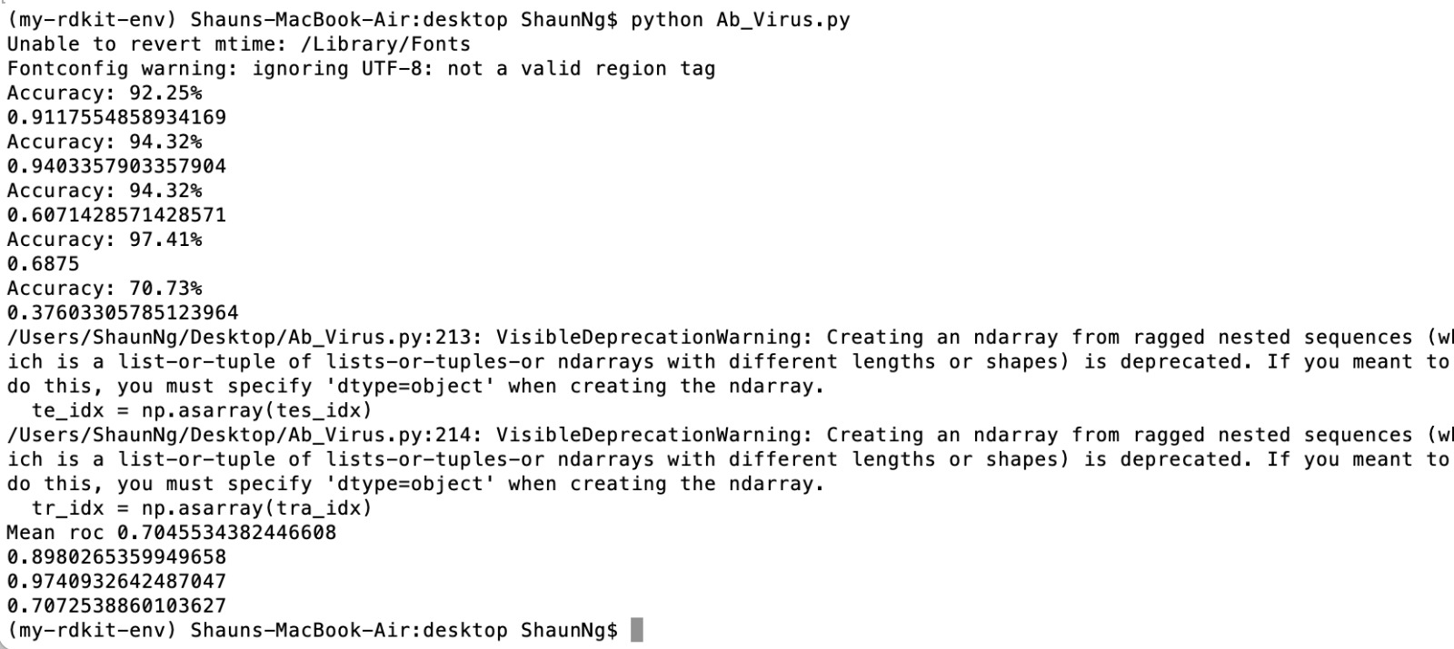
Running the code
Downloaded VirusNet.csv and the python file

Slide 11
What our project can do
(i) Manually obtain COVID antibody-antigen data and combine with existing compiled data to strengthen the ML and make it more catered to COVID
(ii) Generate list of potential antibodies through point mutation of set of COVID antibodies obtained from database shared by Jothy:
(iii) Generate list of potential antibodies through another method (randomly?)
(iv) Optimize the code
(v) Use GNN, CNN
(vi) Further test the stability of antibodies in wet lab

Slide 12
12th January 2022 sharing by Joshua

Slide 13
This week’s progress: replicate the progress of the article: Potential neutralizing antibodies discovered for novel corona virus using machine learning (paper shared earlier)

Slide 14
Code file 1
Jupyter Notebook: Ab_Virus_01_Data_Preprocessing_v01
Input CSV file: VirusNet
Output NumPy file: mean_final_elementwise_sum.npy; mean_final_concatenate.npy

Slide 15
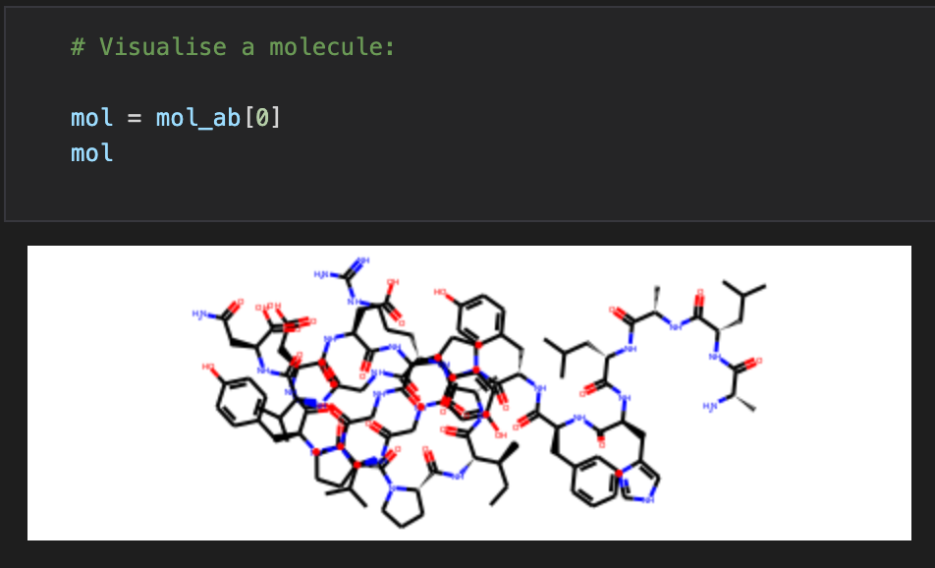
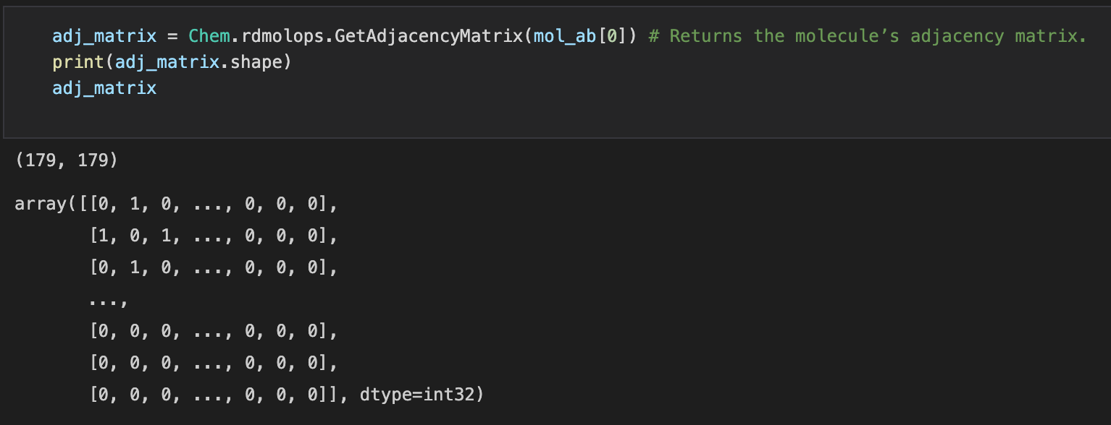
Step 1: Install RDKit library
Capable of represent a FASTA sequence as a molecule, with its 2-D shape provided
Finding the adjacency matrix of a molecule

Slide 16
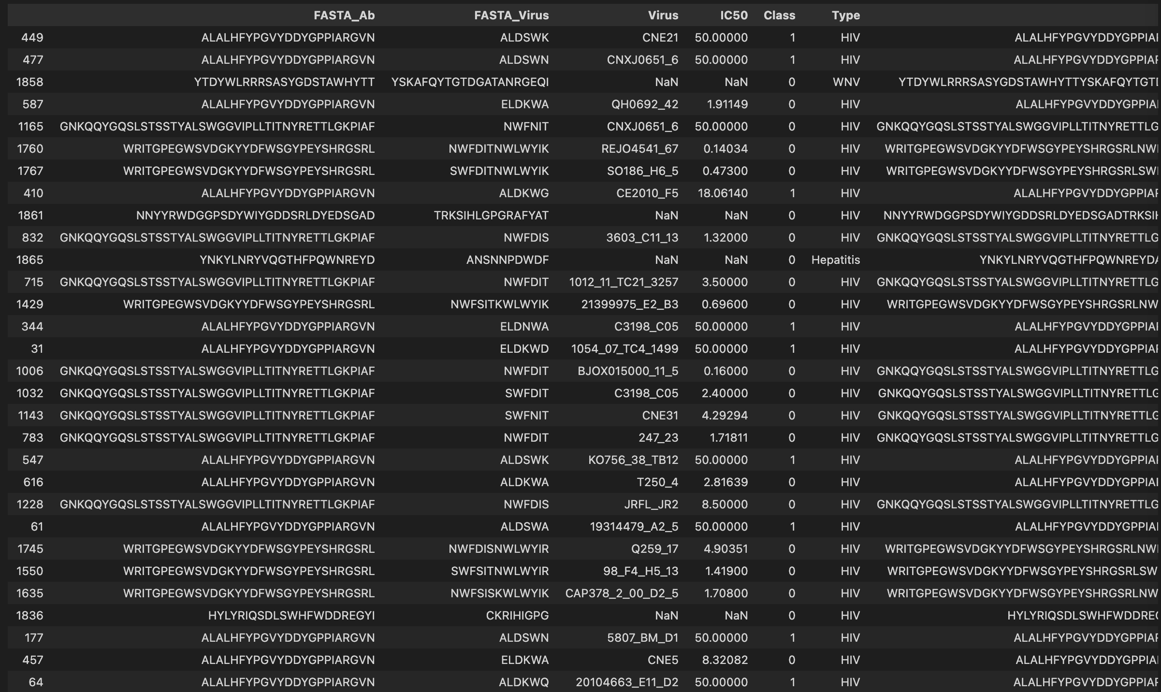
Step 2: Importing training data from csv
Label: neutralizing
or non-neutralising
Type of antibody
/ virus
FASTA of antibody
FASTA of virus
1933 number of antibody / virus combinations
➔ 1933 rows

Slide 17
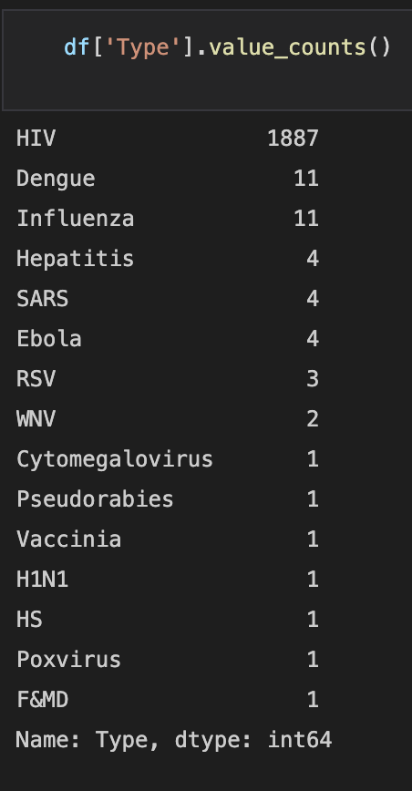
Most of the training data are HIV
Originality 1:
Can use the oxford database to make the training data become more Covid oriented

Slide 18
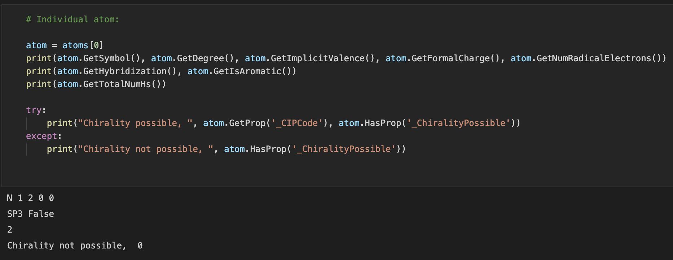
Step 3: Convert FASTA to molecular and atomic representation, and finally to one-hot vector
Each molecule has around 200 atoms (example: 179)
For each atom, extract its features

Slide 19
Convert features to one-hot vector
For each atom inside a molecule:
atom.GetSymbol() → {‘C’, ‘N’, ‘O’, ‘S’, ‘H’, ‘Unknown’}
atom.GetDegree() → { 0, 1, 2, 3, 4, 5, 6, 7, 8, 9, 10}
atom.GetImplicitValence() → {0, 1, 2, 3, 4, 5, 6}
atom.GetFormalCharge() → {0, 1} binary
atom.GetNumRadicalElectrons() → {0, 1} binary
atom.GetHybridization() → {SP, SP2, SP3, SP3D, SP3D2}
atom.GetIsAromatic() → {0, 1} binary
atom.GetTotalNumHs() → {0, 1, 2, 3, 4}

Slide 20
Convert features to one-hot vector
atom.GetDegree() → { 0, 1, 2, 3, 4, 5, 6, 7, 8, 9, 10}
Value
0 1 2 3 4 5 6 7 8 9 10
6
0
0
0
0
0
0
1
0
0
0
0
Value
0 1 2 3 4 5 6 7 8 9 10
2
0
0
1
0
0
0
0
0
0
0
0

Slide 21
Convert features to one-hot vector
For each atom inside a molecule:
atom.GetSymbol() → {‘C’, ‘N’, ‘O’, ‘S’, ‘H’, ‘Unknown’} → 6 features
atom.GetDegree() → { 0, 1, 2, 3, 4, 5, 6, 7, 8, 9, 10} → 11 features
atom.GetImplicitValence() → {0, 1, 2, 3, 4, 5, 6} → 7 features
atom.GetFormalCharge() → {0, 1} binary → 1 features
atom.GetNumRadicalElectrons() → {0, 1} binary → 1 features
atom.GetHybridization() → {SP, SP2, SP3, SP3D, SP3D2} → 5 features
atom.GetIsAromatic() → {0, 1} binary → 1 features
atom.GetTotalNumHs() → {0, 1, 2, 3, 4} → 5 features
Total: 37 features

Slide 22
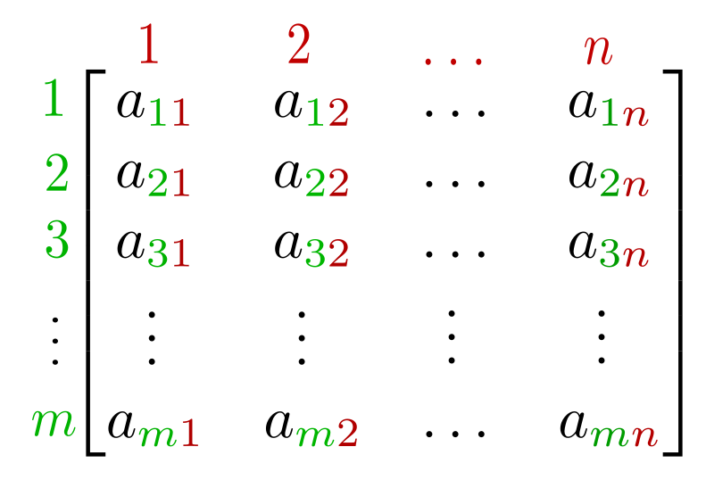
Matrix representation For each molecule:
Features
= 37
Atoms
179 =
179 X 37 matrix

Slide 23
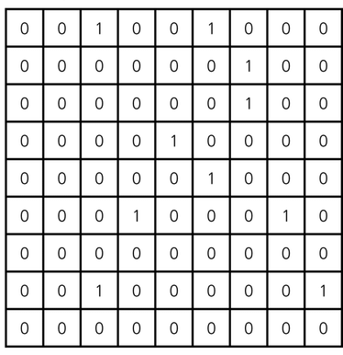
Step 4: Adjacency matrix
For each molecule:
179 atoms
179 atoms
179 X 179 matrix

Slide 24
Step 5: Matrix multiplication For each molecule:
179 atoms
Features
= 37
X
Atoms
179 atoms
179 =
179 X 179 matrix
179 X 37 matrix

Slide 25
The product:
Entries
= 37
=
Entries
179 =
179 X 37 matrix

Slide 26
Step 6: Mean pooling For each molecule
Entries
= 37
37 entries
=
0.78
0.63
0.59
…
….
0.20
Entries
1 X 37 Vector
179 =
179 X 37 matrix
Originality 2:
Prof’s suggestion: we can try max pooling
Pool a mean for each column

Slide 27
So given that you have 1933 antibody molecules and 1933 virus molecules…

Slide 28
It will become…
Antibody dataset
Virus dataset
Entries
Entries
= 37
= 37
Molecules
Molecules
1933 =
1933 =
1933 X 37 matrix
1933 X 37 matrix

Slide 29
Step 7: Journal paper’s approach: Elementwise-sum up two matrices
Antibody
Virus
Entries
Entries
= 37
= 37
+
Molecules
Molecules
1933 =
1933 =
1933 X 37 matrix
1933 X 37 matrix

Slide 30
Elementwise-sum matrix
Entries
Will reduce the number of useful features?
= 37
=
Molecules
1933 =
1933 X 37 matrix

Slide 31
Originality 3: Instead of summing up the matrices, concatenate!
Antibody
Concatenate
Virus
Entries
Entries
= 37
= 37
Molecules
Molecules
1933 =
1933 =
1933 X 37 matrix
1933 X 37 matrix

Slide 32
Concatenated matrix
Antibody
(37 columns)
Virus
(37 columns)
= 74
=
Molecules
1933 =
1933 X 74 matrix

Slide 33
Step 8:
Save as NumPy:
Elementwise-sum matrix: mean_final_additional_elementwise_sum.npy
Conatenated matrix: mean_final_additional_concatenate.npy

Slide 34
Code file 2
Jupyter Notebook: Ab_Virus_02_Model_Selection_v03.ipynb
Input NumPy file: mean_final_elementwise_sum.npy; mean_final_concatenate.npy
Output CSV file: Ab_Virus_02_Model_Selection_v03.csv; Ab_Virus_02_Model_Selection_v03 - edit.xlsx

Slide 35
Originality 4: Expanding on classifiers
On GitHub
On journal paper
Our current input
Can expand
Random Forest
Random Forest
Random Forest
Random Forest
Decision Tree
Decision Tree
Decision Tree
Logistic Regression
Logistic Regression
Logistic Regression
Support Vector Machine
Support Vector Machine
Support Vector Machine
MLP Classifier
MLP Classifier
MLP Classifier
XGBoost
XGBoost
XGBoost
LightGBM
LightGBM
Catboost
Catboost
TabNet
TabNet
Ridge
Not sure if there is LASSO1 and LASSO2 or just LASSO
LASSO 1
LASSO 2
Prof’s suggestion, very hard, can ignore for the time being
Transformer

Slide 36
Splitting training / validation data by 5-Fold What does K-Fold mean?
Assume that you want to split your training data into a training set and a validation set
Normally:
Data
80%
20%
Training
Validation

Slide 37
Splitting training / validation data by 5-Fold What does K-Fold mean?
Splitting into 5-Fold:
Data
20%
20%
20%
20%
20%
1st round
20%
20%
20%
20%
20%
Training
Validation
2nd round
20%
20%
20%
20%
20%
Training
Validation
Training
…
…
5th round
20%
20%
20%
20%
20%
Validation
Training

Slide 38
Replicating GitHub code with 5-Fold
Jupyter Notebook: Ab_Virus_01_Data_Preprocessing_v01.ipynb
Excel output: Ab_Virus_02_Model_Selection_v01.xlsx
 | Accuracy score (%)
 | Element-wise sum (1933 X 37) matrix |  |  |  |  |  | Concatenated (1933 X 74) matrix
 | Kfold |  |  |  |  |  | Kfold
Classifier | 1 | 2 | 3 | 4 | 5 | Mean | 1 | 2 | 3 | 4 | 5 | Mean
Random Forest | 91.47 | 93.28 | 93.54 | 97.41 | 70.47 | 89.23 | 93.80 | 91.99 | 93.54 | 97.15 | 69.69 | 89.23
Decision Tree | 91.99 | 94.32 | 94.57 | 97.15 | 76.17 | 90.84 | 91.73 | 95.35 | 93.80 | 97.41 | 74.35 | 90.53
Logistic Regression | 53.49 | 81.40 | 93.54 | 95.85 | 81.61 | 81.18 | 52.71 | 77.78 | 92.76 | 95.85 | 69.95 | 77.81
Support Vector Machine | 62.02 | 71.06 | 93.54 | 97.15 | 73.58 | 79.47 | 83.72 | 80.62 | 92.76 | 95.85 | 70.47 | 84.69
MLP Classifier | 38.50 | 78.04 | 93.54 | 96.11 | 81.87 | 77.61 | 51.68 | 58.14 | 93.54 | 95.85 | 72.28 | 74.30
XGBoost | 93.80 | 95.61 | 95.09 | 96.89 | 71.50 | 90.58 | 93.80 | 95.87 | 95.35 | 97.67 | 69.69 | 90.47
LightGBM | 89.92 | 90.70 | 93.54 | 95.34 | 75.13 | 88.93 | 91.99 | 90.96 | 93.80 | 96.11 | 69.95 | 88.56
CatBoost | 93.54 | 95.61 | 96.38 | 97.67 | 69.95 | 90.63 | 93.80 | 96.12 | 96.38 | 97.67 | 69.69 | 90.73
TabNet | 37.47 | 67.44 | 83.98 | 95.85 | 28.76 | 62.70 | 37.47 | 57.36 | 92.76 | 95.85 | 8.55 | 58.40
A clear observation that the 5th fold is always worse performing than the previous 4 folds

Slide 39
Why did it happen?
Remember that for our training dataset:
While most data are HIV data, there is a sizable proportion of data that belongs to non-HIV category

Slide 40
Why did it happen?
Imagine if all non-HIV data is concentrated in one “fold”
Quite obvious that, for this fold, the accuracy of validation dataset will fall significantly due to domain adaptation shift problem.
All non-HIV data concentrated here
5th round
20%
20%
20%
20%
20%
Training
Validation

Slide 41
Originality 5: Solve by Repeated Stratified 5-Fold
Stratified K-fold means that, for each fold, the proportion of ‘1’s and ‘0’s in the y value of data is the same.
Normal K-fold:
Stratified K-fold:
Y=1: 55%
Y=0: 45%
Y=1: 63%
Y=0: 27%
Y=1: 82%
Y=0: 18%
Y=1: 91%
Y=0: 9%
Y=1: 72%
Y=0: 28%
Data
Y=1: 55%
Y=0: 45%
Y=1: 55%
Y=0: 45%
Y=1: 55%
Y=0: 45%
Y=1: 55%
Y=0: 45%
Y=1: 55%
Y=0: 45%
Data

Slide 42
Originality 5: Solve by Repeated Stratified 5-Fold
Repeated K-fold means that, it repeats the forementioned Stratified K-Fold model, but with different randomization in each repetition.
Y=1: 55%
Y=0: 45%
Y=1: 55%
Y=0: 45%
Y=1: 55%
Y=0: 45%
Y=1: 55%
Y=0: 45%
Y=1: 55%
Y=0: 45%
Round 1-5
Y=1: 55%
Y=0: 45%
Y=1: 55%
Y=0: 45%
Y=1: 55%
Y=0: 45%
Y=1: 55%
Y=0: 45%
Y=1: 55%
Y=0: 45%
Round 6-10
Round
11-15
Y=1: 55%
Y=0: 45%
Y=1: 55%
Y=0: 45%
Y=1: 55%
Y=0: 45%
Y=1: 55%
Y=0: 45%
Y=1: 55%
Y=0: 45%
The splitting into 5-folds is different and randomized for every 5 rounds

Slide 43
Performance (accuracy rate) with different classifiers:
Jupyter Notebook: Ab_Virus_02_Model_Selection_v03.ipynb
Input NumPy file: mean_final_elementwise_sum.npy; mean_final_concatenate.npy
Output CSV file: Ab_Virus_02_Model_Selection_v03.csv; Ab_Virus_02_Model_Selection_v03 - edit.xlsx

Slide 44
Performance (accuracy rate) with different classifiers:
For each classifier, we run 50 times Repeated Stratified 5-Fold, and take the average, max and min of their accuracy scores
The 5 best performing models:
Random Forest
Decision Tree
XGBoost
LightGBM
Catboost
Notice that, for almost all models (except logistic regression), concatenated matrix is better performing than elementwise-sum

Slide 45
Performance (accuracy rate) with different classifiers:
 | Accuracy score (%)
 | Element-wise sum (1933 X 37) matrix |  |  | Concatenated (1933 X 74) matrix
Classifier | average | max | min | average | max | min
Random Forest | 95.67 | 97.67 | 93.52 | 95.99 | 97.42 | 94.04
Decision Tree | 94.88 | 97.16 | 92.23 | 95.33 | 97.16 | 94.04
Logistic Regression | 87.06 | 89.15 | 83.72 | 85.64 | 88.89 | 82.38
Support Vector Machine | 86.14 | 89.12 | 79.53 | 91.88 | 94.57 | 89.38
MLP Classifier | 81.78 | 88.89 | 72.02 | 83.63 | 88.86 | 71.58
XGBoost | 95.60 | 97.67 | 93.26 | 95.71 | 97.42 | 94.06
LightGBM | 95.61 | 97.67 | 93.28 | 95.81 | 97.42 | 93.80
CatBoost | 95.66 | 97.42 | 93.28 | 95.95 | 97.67 | 93.80
TabNet | 66.11 | 77.78 | 24.35 | 75.27 | 82.69 | 67.10
Notice that, for almost all models (except logistic regression), concatenated matrix is better performing than elementwise-sum

Slide 46
Code file 3
Jupyter Notebook: Ab_Virus_03_HP_Random_Search_v03.ipynb (Google drive)
Input NumPy file: mean_final_elementwise_sum.npy; mean_final_concatenate.npy
Output: Best model, best hyperparameters

Slide 47
Originality 6: Hyperparameter grid-search
We can perform hyperparameter grid-search on the 9 classifier models, in order to select the best performing model for our final model prediction
Computationally expensive and requires GPU
First trial on my laptop for XGBoost model, random search HP for 100 times,
GPU deployed: GeForce RTX 2060
Takes 1 hour to train
Consumes 30GB of my memory in my SSD drive (can restart PC to delete those cache memory)
Solution 1: Push it to Google Drive to run the model
Solution 2: Limit our scope to only the best performing models: Random Forest, Decision Tree, XGBoost, LightGBM, Catboost
See my code file → Ab_Virus_03_HP_Random_Search_v03.ipynb (Google drive)

Slide 48
Discussion point
Given the computational resource constraint, should we:
Limit our scope to 1 single classifier model, but increase the random search effort to 500 or 1,000 sets of hyperparameters, or
Keep the 5 best performing classifiers, each perform random search on 100 sets of HPs, or
Expand to all classifiers, each perform 100 or less random searches of HPs
Which strategy should we adopt?

Slide 49
Code file 4
Jupyter Notebook: Ab_Virus_04_Data_Preprocessing_v01
Input CSV file: VirusNet_addition
Output NumPy file: mean_final_additional_elementwise_sum.npy; mean_final_additional_concatenate.npy

Slide 50
Repeats of code file 1, but for prediction
Basically is the repeat of code file 1, but this time the csv data input is the file “VirusNet_addition”.
Input file doesn’t have IC50 value or the labelling of neutralizing / non-neutralizing.
We need to predict the results with our pre-trained model.
Sample contains 416 pairs of antibody / virus, out of which 2 pairs cannot be run through the RDKit library, so effectively we are left with 414 data points.

Slide 51
Remember our originality point 1
Originality 1:
Can use the oxford database to make the training data become more Covid oriented

Slide 52
Code file 5
Jupyter Notebook: Ab_Virus_05_Data_Preprocessing_v01
Input NumPy file: mean_final_additional_elementwise_sum.npy; mean_final_additional_concatenate.npy
Output CSV file: VirusNet_additional_predict.csv; VirusNet_additional_predict_edit.xlsx

Slide 53
Repeats of code file 2, but for prediction
Basically is the repeat of code file 1, but this time the NumPy data input is the file “mean_final_additional_elementwise_sum.npy” and “mean_final_additional_concatenate.npy”
Input file doesn’t have labelling of neutralizing / non-neutralizing.
We need to predict the results with our pre-trained model.
Sample contains 416 pairs of antibody / virus, out of which 2 pairs cannot be run through the RDKit library, so effectively we are left with 414 data points.

Slide 54
Results
 | Numbers predicted out of 414 sample
 | Element-wise sum (1933 X 37) matrix |  | Concatenated (1933 X 74) matrix
Classifier | Neutralising | Non-neutralising | Neutralising | Non-neutralising
Random Forest | 7 | 407 | 3 | 411
Decision Tree | 23 | 391 | 21 | 393
Logistic Regression | 68 | 346 | 79 | 335
Support Vector Machine | 51 | 363 | 20 | 394
MLP Classifier | 122 | 292 | 3 | 411
XGBoost | 16 | 398 | 8 | 406
LightGBM | 9 | 405 | 8 | 406
CatBoost | 11 | 403 | 0 | 414
TabNet | 115 | 299 | 115 | 299

Slide 55
Pattern
Models that show higher accuracy score in the prior training stage will predict less number of neutralizing antibody-virus pairs than models that show lower accuracy score in the prior training stage.
A likely estimate of the number of neutralizing antibody-virus pairs should be within the range of 0-23

Slide 56
Recap on originality points

Slide 57
Recap on originality points
Oxford database: training data more Covid oriented
Max-pooling for each molecule’s (1 X 37) vector
Concatenated matrix (1933 X 74) for antibody / virus
Expand on classifiers ← can ignore Transformer for now, focus on Ridge and LASSO
Repeated Stratified K-Fold
Hyperparameter grid search
Red means we can do further work on it

Slide 58
Reflection: Research Approach

Slide 59
My best understanding of the project scope: Antibody prediction
Given a pair of antibody and coronavirus protein structure, determine whether this pair is neutralizing or non-neutralizing
The output should ideally be 1 or 0:
1 means neutralizing
0 means non-neutralizing
→ binary classification

Slide 60
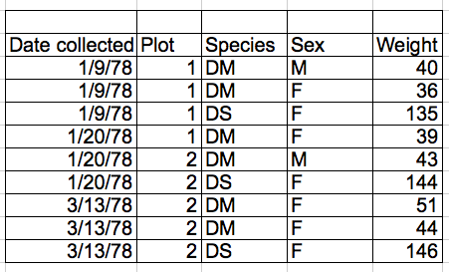
What is tabular data
Data in a table form, example: excel
Usually stored in csv file format (excel readable and human readable)
Each row is a data, each column is a feature
Can be viewed as a [n X k] matrix form, n = number of data, k = number of features
Very easy for binary classification tasks: For each row of data, predict whether it is 1 or 0
k columns, each column is a feature
n rows, each row is a data

Slide 61
Binary classification model
The 12 forementioned classification models:
Random Forest, Decision Tree, Logistic Regression, Support Vector Machine, MLP Classifier, XGBoost, LightGBM, Catboost, TabNet, Ridge, LASSO I & II
They are all useful for binary classification tasks
Some are only capable of binary classification, some are capable of multiple class classifications
For the purpose of this project, we can treat them as binary classification models

Slide 62
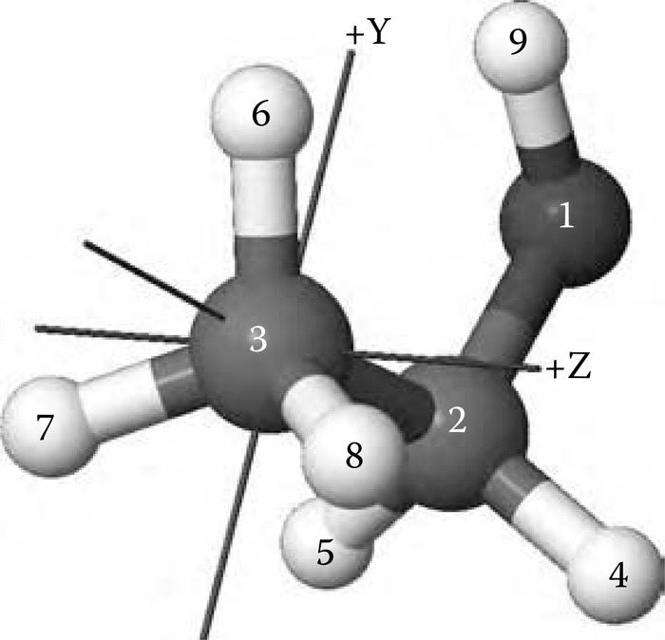
3-D coordinate data
Each atom of a molecule has its respective 3-D coordinate, then data stores the 3-D coordinate of each molecule
Or, in more simple form, it can just be an adjacency matrix for each atom that belongs to the same molecule
→ Useful for GNN model
OR
3-D coordinate representation of each atom belonging to the same molecule
Adjacency matrix

Slide 63
How I picture our research approach
Journal paper
3-D coordinate data
Oxford dataset
Tabular data
GNN
Binary classification models
Our current progress
Can be very hard
Transformer
What we can explore

